Slide 1

What Is Organizing?
Deciding how best to group organizational activities and resources.
Why Organize?
Because all the structural elements of the company and how those elements work together are used to manage the total organization.
What are the building blocks of organizing?
  Organization Structure:
    The set of elements that can be used to configure an organization.

Slide 2
Basic Elements of Organization Design
Job Design
Departamentalization (grouping job)
Establishing Reporting Relationship
Distribution of Authority
Coordinating Activities
Differentiating Between Position

Slide 3
The Importance of Organizing
Clarifies
Divides
Provides
Establishes
Develops
Relates
Establishes authority
Organizing Leads to Decision Making
Decision making is part of planning that involves selecting a course of action.
When the manager is organized activities are coordinated.

Slide 4
Organizational Structure
The building blocks used to form an organization.
One of the manager’s jobs is to know how to put the building blocks together.

Slide 5
What are the building blocks
Job Design: The determination of an individual’s work-related responsibilities
Job Specialization:
  The degree to which the overall task of the organization is broken down and divided into smaller component parts.
  Alternatives to Job Specialization
Job Rotation:
  Involves systematically moving employees from one job to another.
Job Enlargement:
  Involves increasing the total number of tasks worker performs.
Job Enrichment:
  Involves increasing both the number of tasks the worker does and the control the worker has over the job.

Slide 6
Job Characteristics Approach:
  Suggests that jobs should be diagnosed and improved along five core dimensions, taking into account both the work system and employee preferences.
This is an alternative to job specialization. This approach suggests that jobs should be diagnosed and improved along five core dimensions:
  Skill variety
  Task identity
  Task significance
  Autonomy
  Feedback
Work Teams:
  Allows an entire group to design the work system it will use to perform an interrelated set of tasks.

Slide 7
Grouping Jobs: Departmentalization
What is it?
  The process of grouping jobs according to some logical arrangement.
Functional Departmentalization:
  Grouping jobs involving the same or similar activities.
Product Departmentalization:
  Grouping activities around products or product groups.

Slide 8
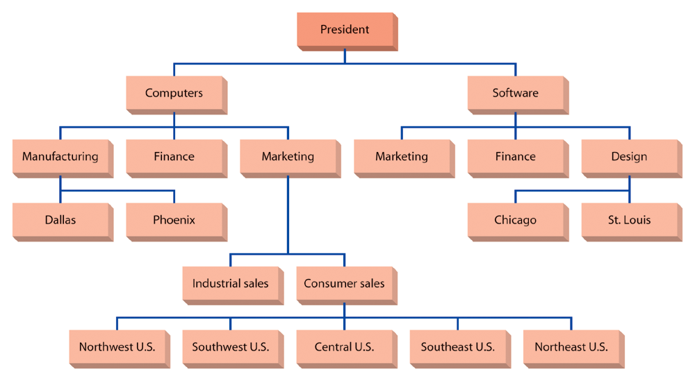
Figure 11.2: Bases for Departmentalization:

Slide 9
Other Forms of Departmentalization:
Some organizations group certain activities by:
  Time.
  Sequence.
Sometimes departments are called something different, such as:
  Division.
  Units.
  Section.
  Bureaus.

Slide 10
Establishing Reporting Relationships
What needs to be clarified?
  Chain of Command:
    Clear and distinct lines of authority among all positions in an organization.
  Span of Management: What is it?
    The number of people who report to each manager.
  Tall Versus Flat Organizations
What is the difference?
  Flat organizational structure leads to higher levels of employee morale and productivity.
  Tall organizational structures usually tend to be more expensive requiring more managers.

Slide 11

Factors Influencing the Span of Management
Competence of supervisor and subordinates.
Dispersion of subordinates.
Extent of non-supervisory work.
Degree of required supervision.
Extent of standard procedures.
Similarity of tasks.
Frequency of new problems.
Preferences of supervision.

Slide 12
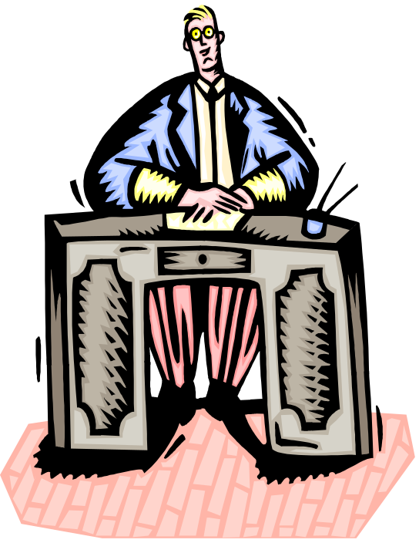
Distributing Authority: An Important Building Block
Authority:
  Power that has been legitimized by the organization.
Delegation:
  The process by which managers assign a portion of their total workload to others.

Slide 13
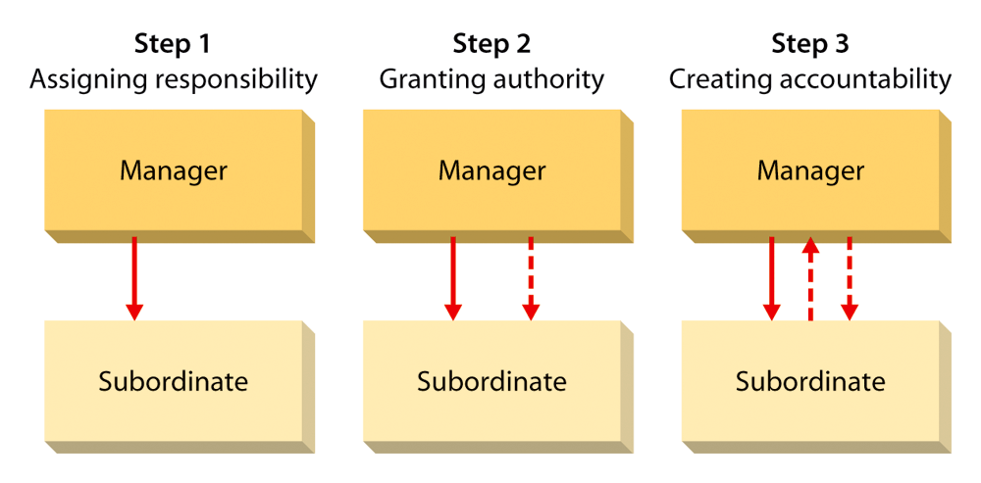
Figure 11.4: Steps in the Delegation Process

Slide 14
Decentralization and Centralization
What are the differences?
  Decentralization:
    The process of systematically delegating power and authority throughout the organization to middle- and lower-level managers.
  Centralization:
    The process of systematically retaining power and authority in the hands of upper-level managers.

Slide 15
Coordinating Activities
What is coordination?
  The process of linking the activities of the various departments of the organization.
Why coordinate?
  Systems must be put into place to keep the activities of each department focused on organizational goal attainment.
Three Major Forms of Interdependence
Pooled Interdependence:
  When units operate with little interaction; their output is simply pooled at the organizational level.
Sequential Interdependence:
  When the output of a unit becomes input for another unit.
Reciprocal Interdependence:
  When activities flow both ways.

Slide 16

Structural Coordination Techniques
Managerial hierarchy.
Rules and procedures.
Liaison roles.
Task force.

Slide 17
What Is the Difference Between Line and Staff?
Line Position:
  A position in the direct chain of command that is responsible for the achievement of an organization’s goals.
Staff Position:
  A position intended to provide expertise, advise, and support for the line position.

